Slide 1
Artificial Intelligence
A brief Introduction To Artificial Intelligence.

Slide 2
Introduction

Slide 3
What is Artificial Intelligence?
Artificial: Artificial is something that is made or produced by human beings rather than occurring naturally, typically as a copy of something natural.
Intelligence is: the ability to acquire and apply knowledge and skills.
So what is artificial intelligence?: The power of a machine to copy intelligent human behavior -Merriam-Webster.

Slide 4
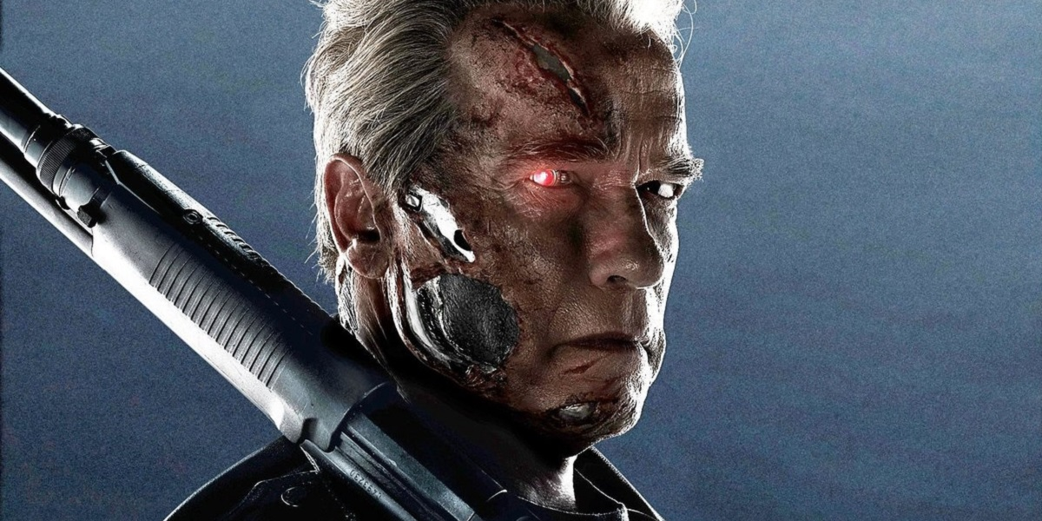
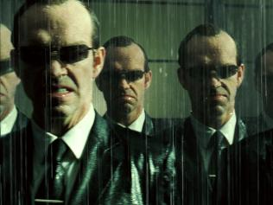
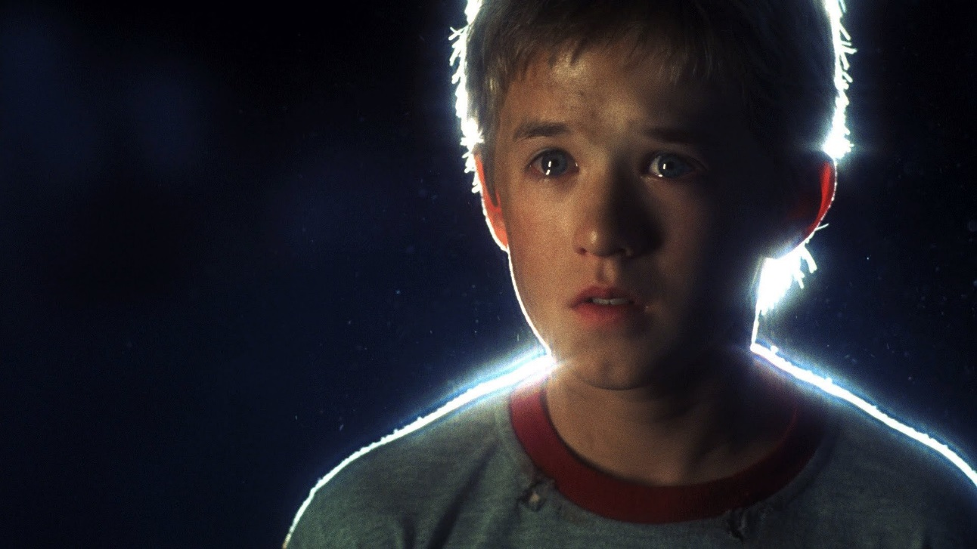
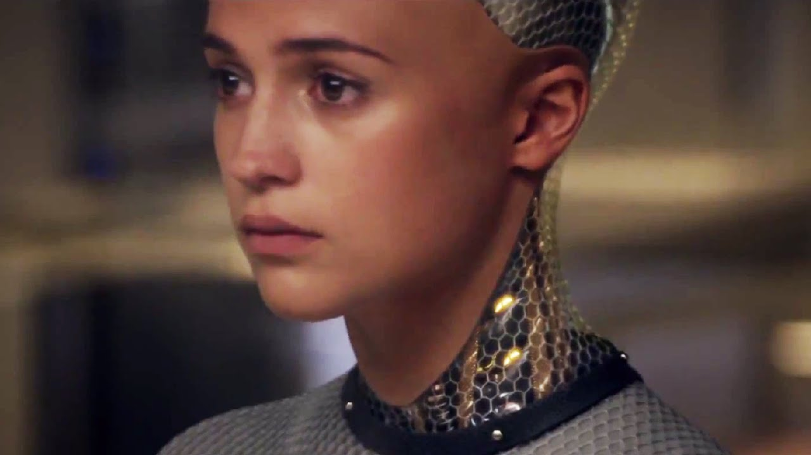

Slide 5
So why should you care about Artificial Intelligence?
Because A.I’s are everywhere.
Self driving Car.
Auto Pilot.
Automatic Traffic Control System.
Chatbots.
Face Detection.
Virtual Assistant.
Behavior Tracers for Ads
Language Translators.

Slide 6
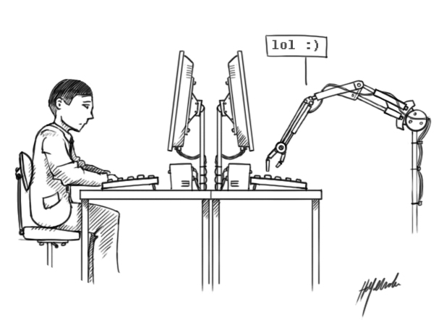
The Turing test: A test for intelligence in a computer, requiring that a human being should be unable to distinguish the machine from another human being by using the replies to questions put to both.
How to tell if a machine Is intelligent?

Slide 7
AI: Good sides:
Remote controlled surgical procedure.
Advanced weather report.
Advanced war machines.
Manufacturing Arms in industries.
Analyzing Trends.
Voice and Character Recognition.
Helping People with Mental Illness.
Video Game A.I.

Slide 8
AI: Bad sides:
Taking over jobs of humans.
Limited Ablility.
Can’t Handle Emergency Situation.
High Cost
Difficult to Code.

Slide 9
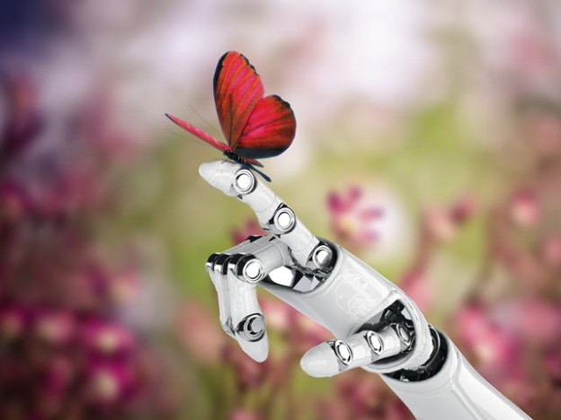
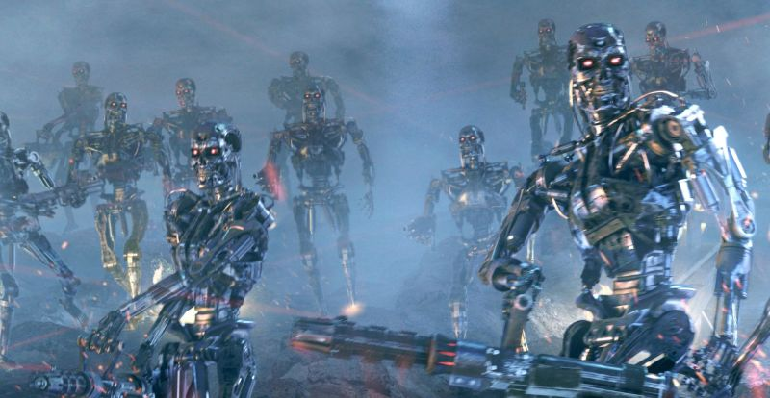
The Future?
The future is really unknown.
Researcher seem to disagree a lot in this issue.
Good?
Bad?

Slide 10
Conclusion

Slide 11
THANK YOU

